Slide 1
Lecture 5
DTMC – Marginal Distribution and Chapman-Kolmogorov Equations

Slide 2
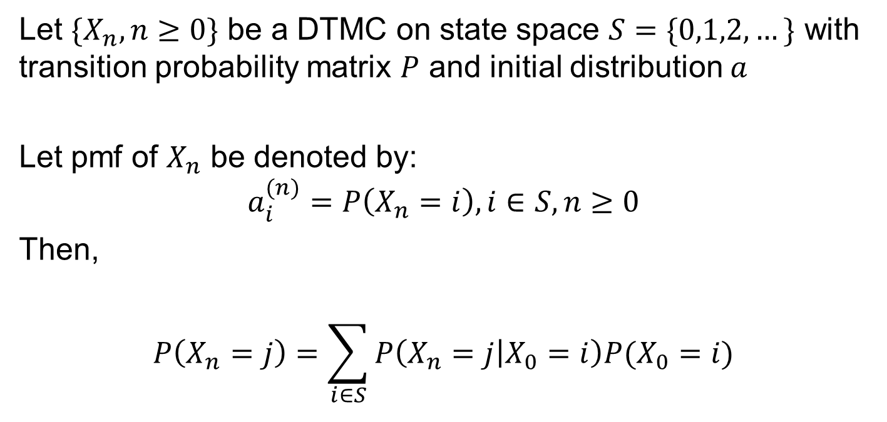
Marginal Distribution
Let $\{X_{n},n≥0\}$ be a DTMC on state space $S=\{0,1,2,…\}$ with transition probability matrix $P$ and initial distribution $a$
Let pmf of $X_{n}$ be denoted by:
$$a_{i}^{(n)}=P\left(X_{n}=i\right), i∈S, n≥0$$
Then,
$$P\left(X_{n}=j\right)=\sum_{i∈S}{P\left(X_{n}=j | X_{0}=i\right)P(X_{0}=i)}$$

Slide 3
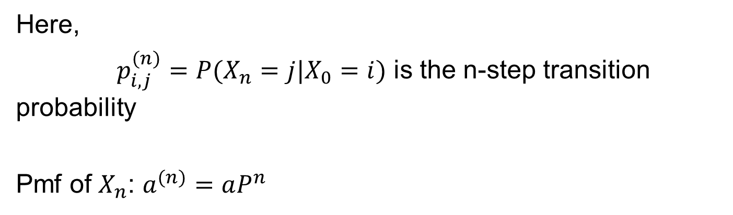
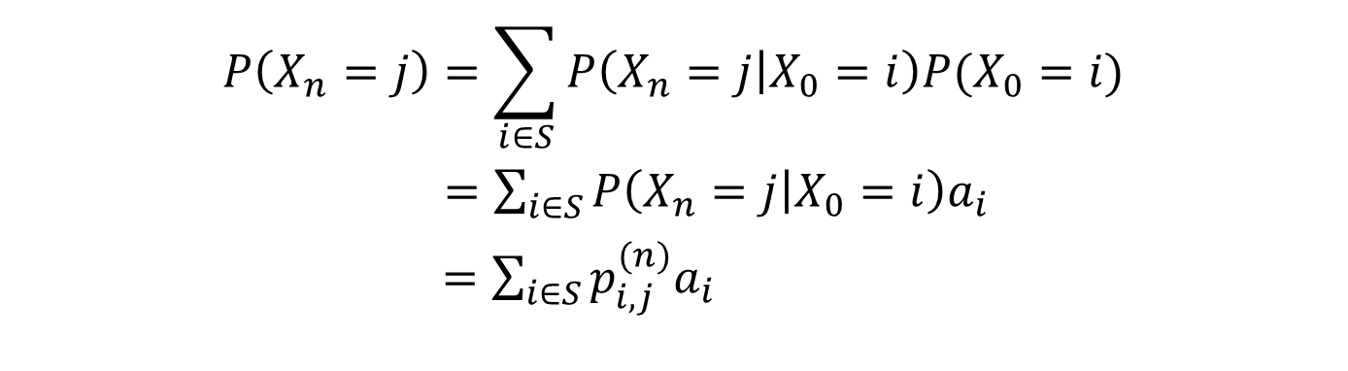
N-step Transition Probability
$$P\left(X_{n}=j\right)=\sum_{i∈S}{P\left(X_{n}=j | X_{0}=i\right)P(X_{0}=i)}$$
$=\sum_{i∈S}{P\left(X_{n}=j | X_{0}=i\right)a_{i}}$
$=\sum_{i∈S}{p_{i,j}^{(n)}a_{i}}$
Here,
$p_{i,j}^{(n)}=P(X_{n}=j|X_{0}=i)$ is the n-step transition probability
Pmf of $X_{n}$: $a^{(n)}=aP^{n}$

Slide 4
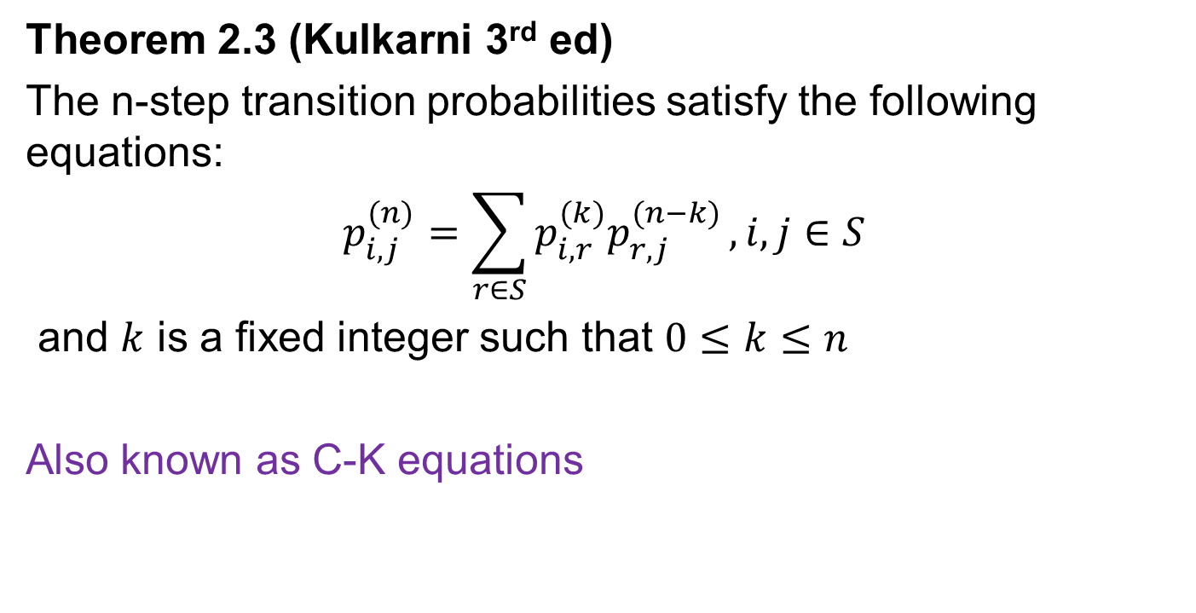
Chapman-Kolmogorov Equations
Theorem 2.3 (Kulkarni 3rd ed)
The n-step transition probabilities satisfy the following equations:
$$p_{i,j}^{(n)}=\sum_{r∈S}{p_{i,r}^{(k)}p_{r,j}^{(n−k)}}, i,j∈S$$
and $k$ is a fixed integer such that $0≤k≤n$
Also known as C-K equations

Slide 5
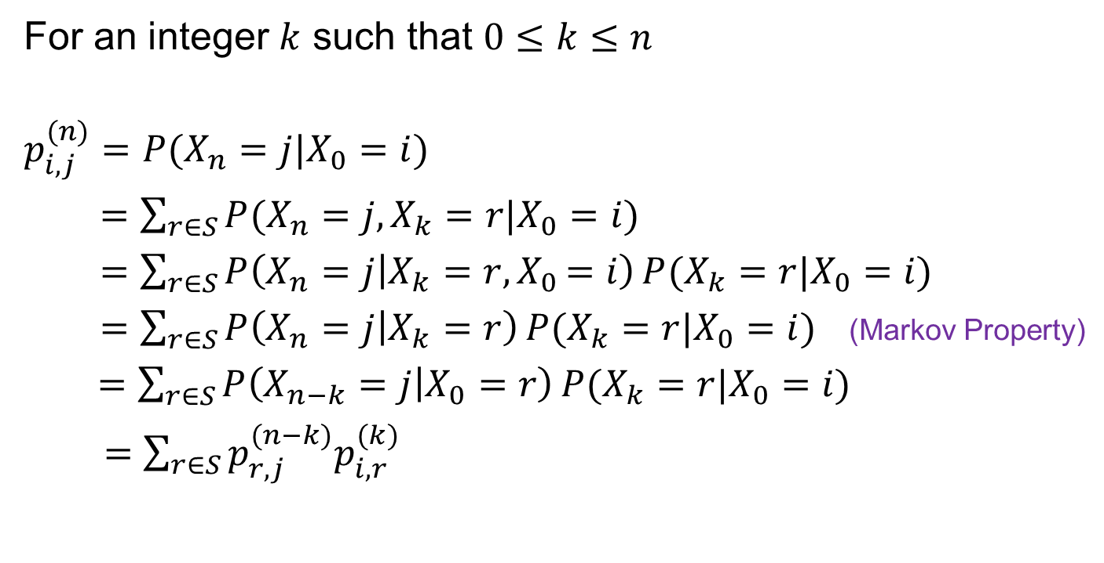
C-K Equations : Proof
For an integer $k$ such that $0≤k≤n$
$$p_{i,j}^{(n)}=P(X_{n}=j|X_{0}=i)$$
$=\sum_{r∈S}{P(X_{n}=j, X_{k}=r|X_{0}=i)}$
$=\sum_{r∈S}{P\left(X_{n}=j | X_{k}=r{,X}_{0}=i\right)}P(X_{k}=r|X_{0}=i)$
$=\sum_{r∈S}{P\left(X_{n}=j | X_{k}=r\right)}P(X_{k}=r|X_{0}=i)$ (Markov Property)
$=\sum_{r∈S}{P\left(X_{n−k}=j | X_{0}=r\right)}P(X_{k}=r|X_{0}=i)$
$=\sum_{r∈S}{p_{r,j}^{(n−k)}p_{i,r}^{(k)}}$

Slide 6

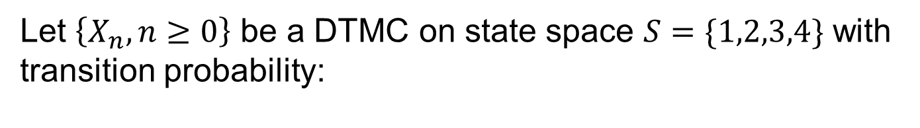
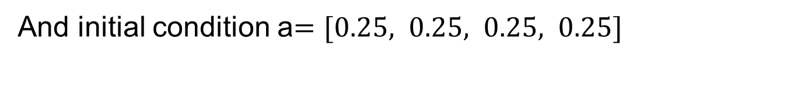
Example - Revsit
Let $\left\{X_{n},n≥0\right\}$ be a DTMC on state space $S=\{1,2,3,4\}$ with transition probability:
0.1 0.2 0.3 0.4
0.2 0.2 0.3 0.3
0.5 0.0 0.5 0.0
0.6 0.2 0.1 0.1
$$P=$$
And initial condition a$=[0.25, 0.25, 0.25, 0.25]$

Slide 7
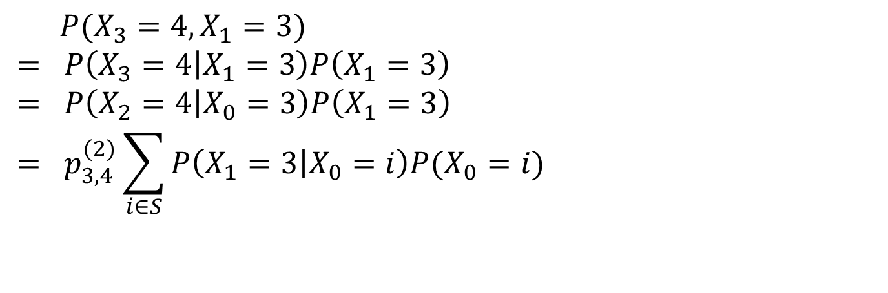
Example – Question 1
Compute $P(X_{3}=4, X_{1}=3)$
$$P(X_{3}=4, X_{1}=3)$$
$$= P\left(X_{3}=4 | X_{1}=3\right)P\left(X_{1}=3\right)$$
$$= P\left(X_{2}=4 | X_{0}=3\right)P\left(X_{1}=3\right)$$
$$= p_{3,4}^{(2)}\sum_{i∈S}{P\left(X_{1}=3 | X_{0}=i\right)P(X_{0}=i)}$$

Slide 8
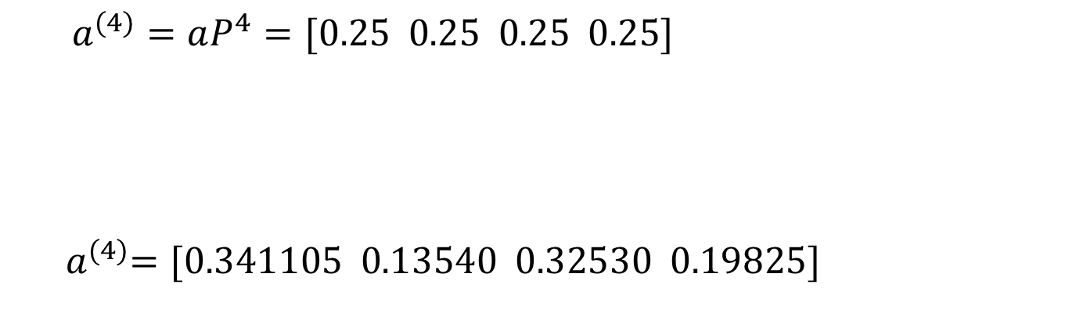
Example – Question 2
Compute pmf of $X_{4}$
0.1 0.2 0.3 0.4
0.2 0.2 0.3 0.3
0.5 0.0 0.5 0.0
0.6 0.2 0.1 0.1
4
$$a^{(4)}=aP^{4}=[0.25 0.25 0.25 0.25]$$
${ a}^{(4)}=[0.341105 0.13540 0.32530 0.19825]$

Slide 9
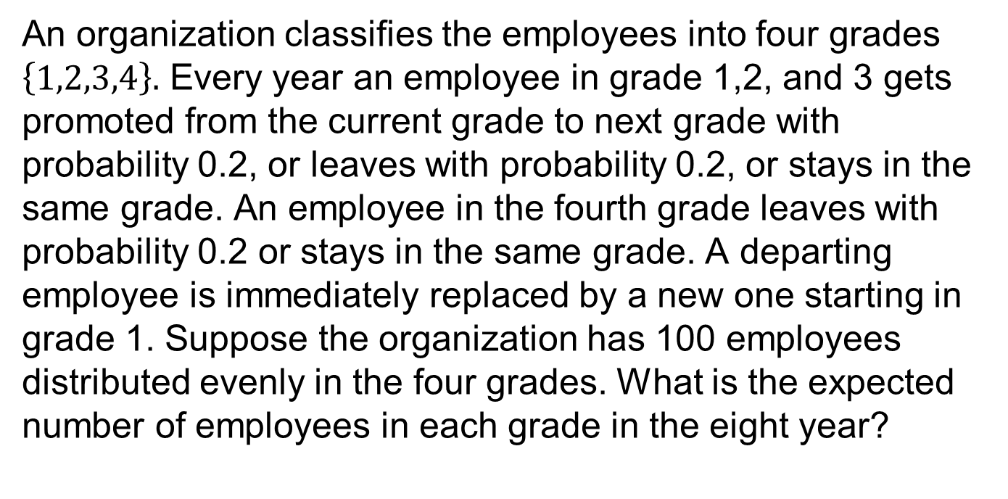
Example 2.23 (Kulkarni 3rd ed)
An organization classifies the employees into four grades $\left\{1,2,3,4\right\}.$ Every year an employee in grade 1,2, and 3 gets promoted from the current grade to next grade with probability 0.2, or leaves with probability 0.2, or stays in the same grade. An employee in the fourth grade leaves with probability 0.2 or stays in the same grade. A departing employee is immediately replaced by a new one starting in grade 1. Suppose the organization has 100 employees distributed evenly in the four grades. What is the expected number of employees in each grade in the eight year?

Slide 10

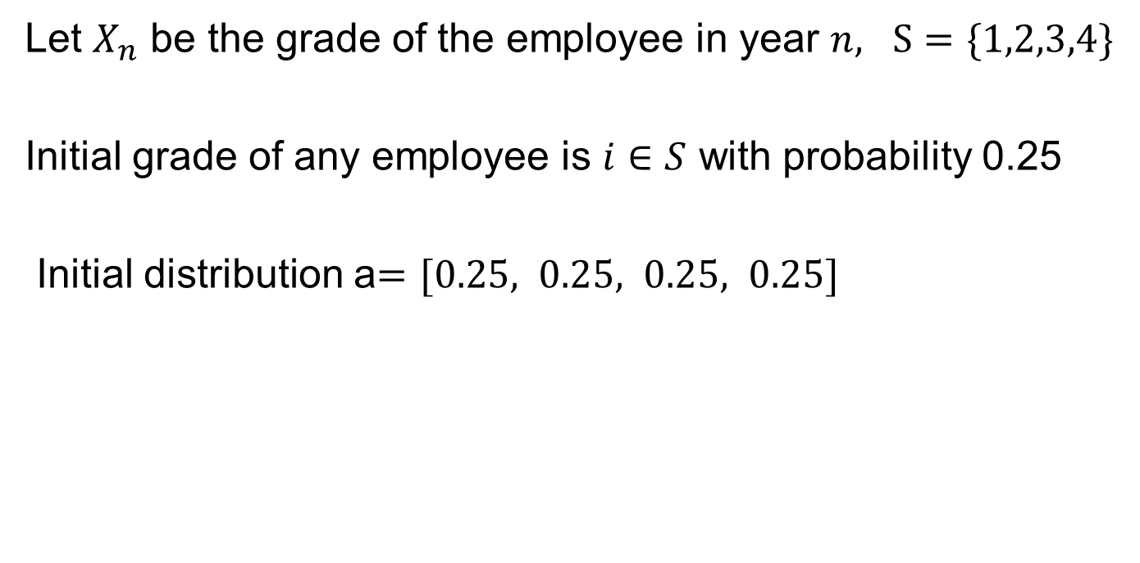
Example 2.23 - Solution
Let $X_{n}$ be the grade of the employee in year $n, S=\{1,2,3,4\}$
Initial grade of any employee is $i∈S$ with probability 0.25
Initial distribution a$=[0.25, 0.25, 0.25, 0.25]$
0.8 0.2 0.0 0.0
0.2 0.6 0.2 0.0
0.2 0.0 0.6 0.2
0.2 0.0 0.0 0.8
$$P=$$

Slide 11
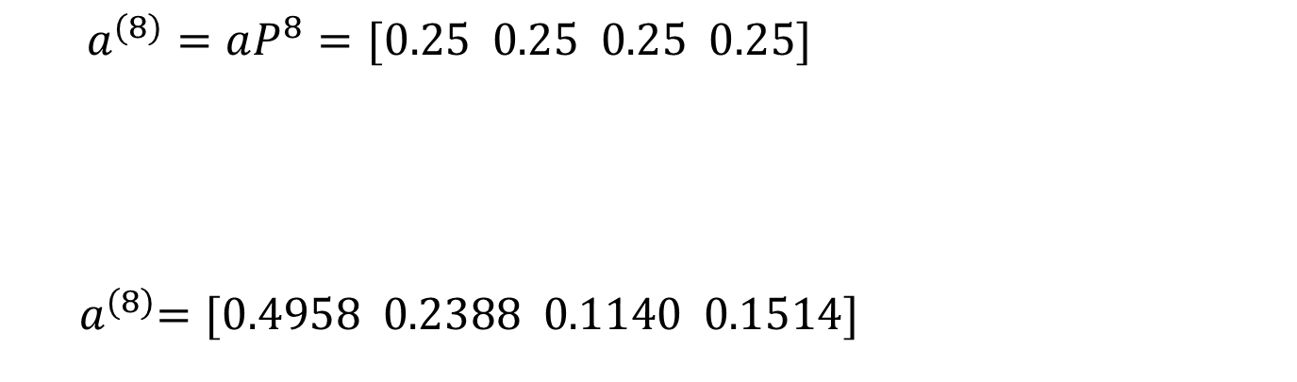
Example 2.23 - Solution
pmf of employee in year 8 is same as pmf of $X_{8}$
8
0.8 0.2 0.0 0.0
0.2 0.6 0.2 0.0
0.2 0.0 0.6 0.2
0.2 0.0 0.0 0.8
$$a^{(8)}=aP^{8}=[0.25 0.25 0.25 0.25]$$
${ a}^{(8)}=[0.4958 0.2388 0.1140 0.1514]$

Slide 12
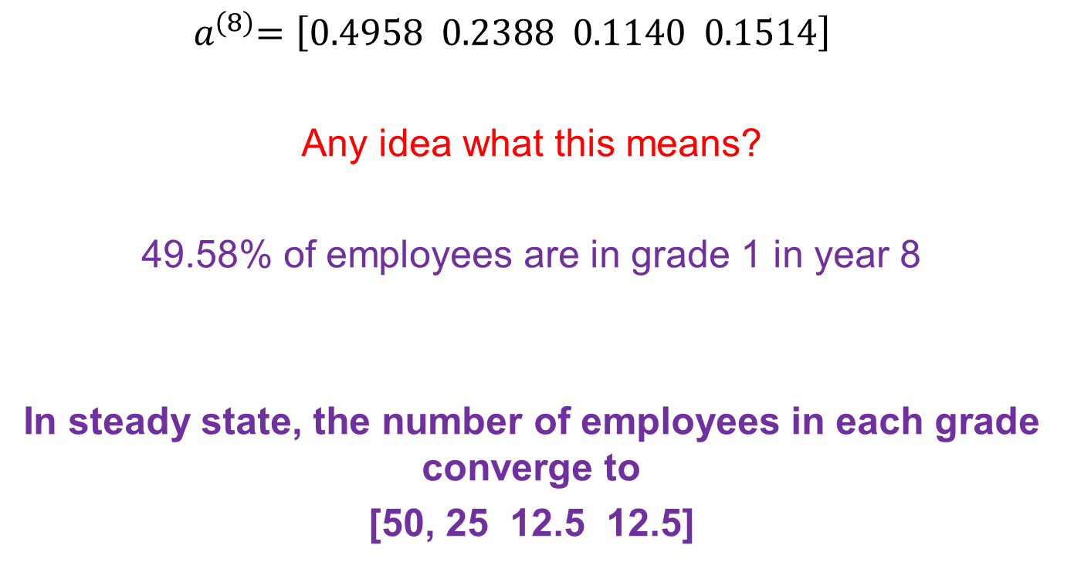
Example 2.23 - Interpretation
${ a}^{(8)}=\left[0.4958 0.2388 0.1140 0.1514\right]$
Any idea what this means?
49.58% of employees are in grade 1 in year 8
In steady state, the number of employees in each grade converge to
[50, 25 12.5 12.5]

